Slide 1


⁶⁴Cu and ⁴⁷Sc (n,p) Cross-Section Measurements for Medical Radionuclide Production
A.S. Voylesª, M.S. Basunia^{b}, J.C. Batchelder^{b}, J.D. Bauer^{c}, L.A. Bernstein^{a,b}, E.F. Matthewsª, M.A. Unzuetaª
31 August 2016
WTTC ’16
ª The University of California, Berkeley – Department of Nuclear Engineering ^{b} Lawrence Berkeley National Laboratory ^{c} Lawrence Livermore National Laboratory

Slide 2
Why Should You Care?

Slide 3
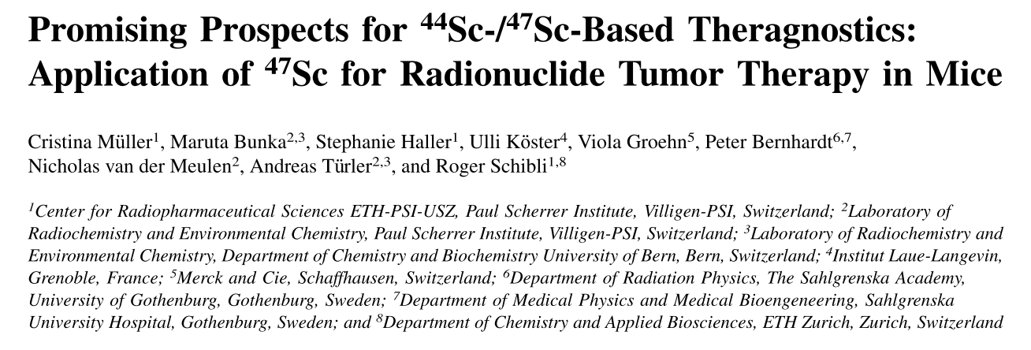
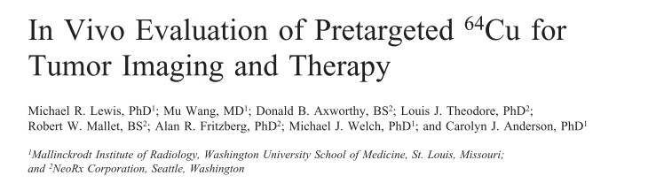
Why Should You Care?
Emerging medical radionuclides
⁶⁴Cu (t_{1/2} = 12.7 hr) – 61% β⁺ to ⁶⁴Ni, 39% β⁻ to ⁶⁴Zn
⁴⁷Sc (t_{1/2} = 3.35 d) – β⁻ to ⁴⁷Ti, with 159-keV γ

Slide 4
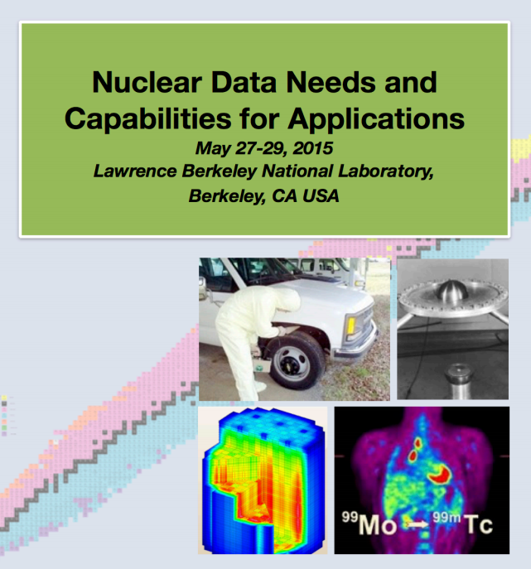
Why Should You Care?
Emerging medical radionuclides
⁶⁴Cu (t_{1/2} = 12.7 hr) – 61% β⁺ to ⁶⁴Ni, 39% β⁻ to ⁶⁴Zn
⁴⁷Sc (t_{1/2} = 3.35 d) – β⁻ to ⁴⁷Ti, with 159-keV γ
Nuclear data as fundamental tools

Slide 5
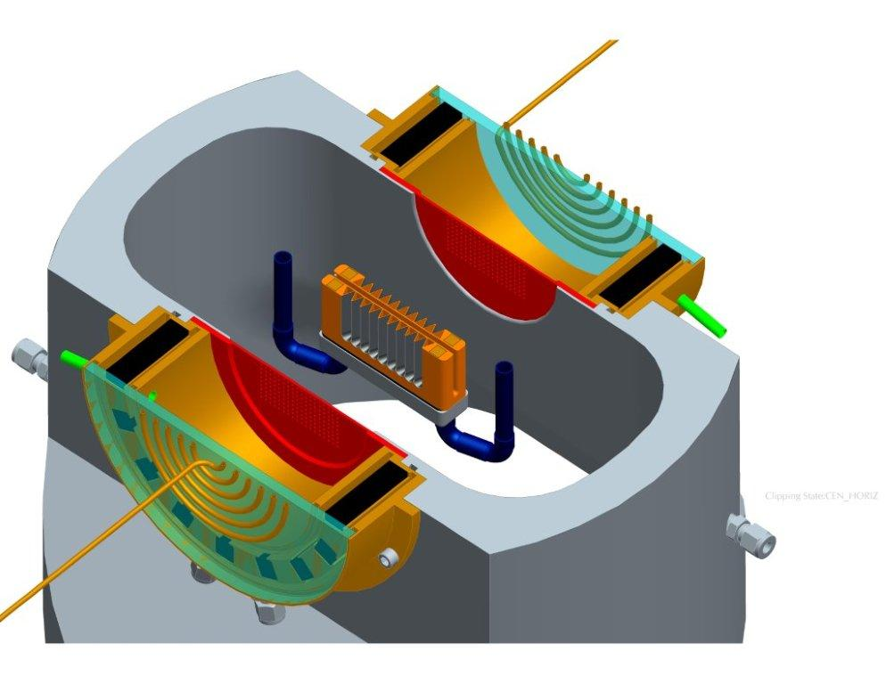
The UC Berkeley High Flux Neutron Generator
Commissioning:
25 July 2016
RF
2.45 MeV neutrons, 10⁸ n/s/cm²
D Plasma
100kV
DD Fusion
D beam
1-1000mA
Deuterium Gas
H₂O

Slide 6
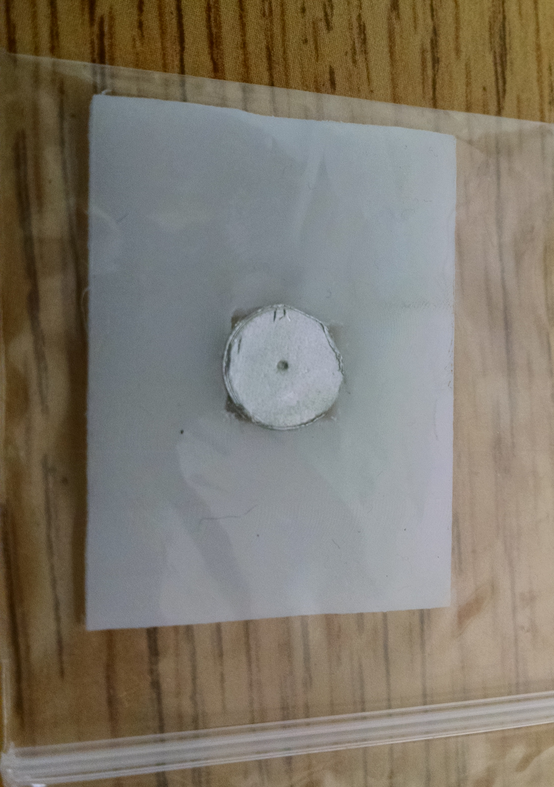
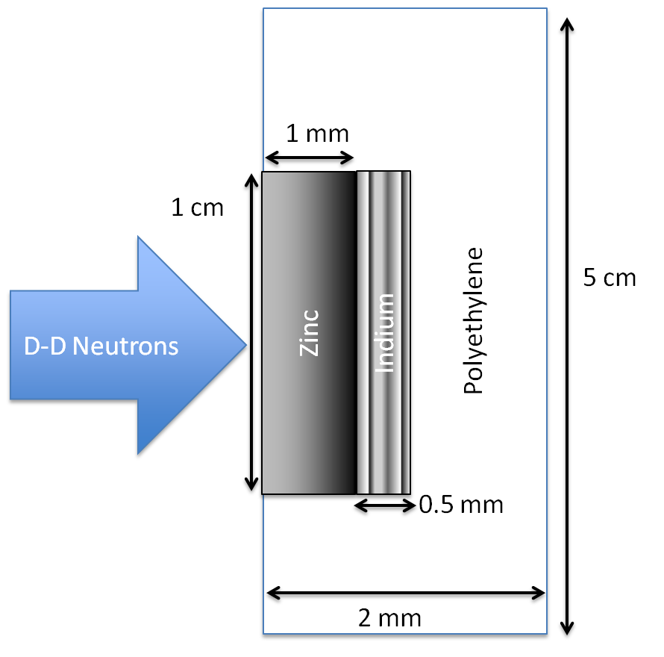
The UC Berkeley High Flux Neutron Generator
Foils Used | Metal Purity | Abundance (a/o) | Foil Density (mg/cm²)
^{nat}In | > 99.999% | ¹¹³In (4.29%), ¹¹⁵In (95.71%) | 365.5
^{nat}Zn | > 99.99% | ⁶⁴Zn (49.17%) | 714.1
^{nat}Ti | 99.999% | ⁴⁷Ti (7.44%) | 450.6
Notes:
64Zn - 49.17%, 66Zn – 27.73%, 67Zn – 4.04%, 68Zn – 18.45%
46Ti – 8.25%, 47Ti – 7.44%, 48Ti – 73.72%, 49Ti – 5.41%, 50Ti – 5.18%

Slide 7
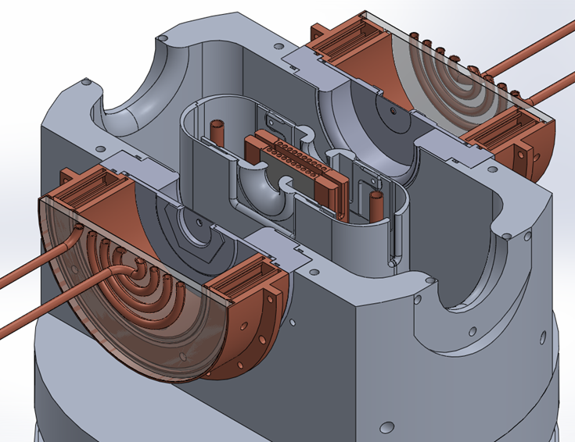
The UC Berkeley High Flux Neutron Generator
Zn
Zn
In
In

Slide 8
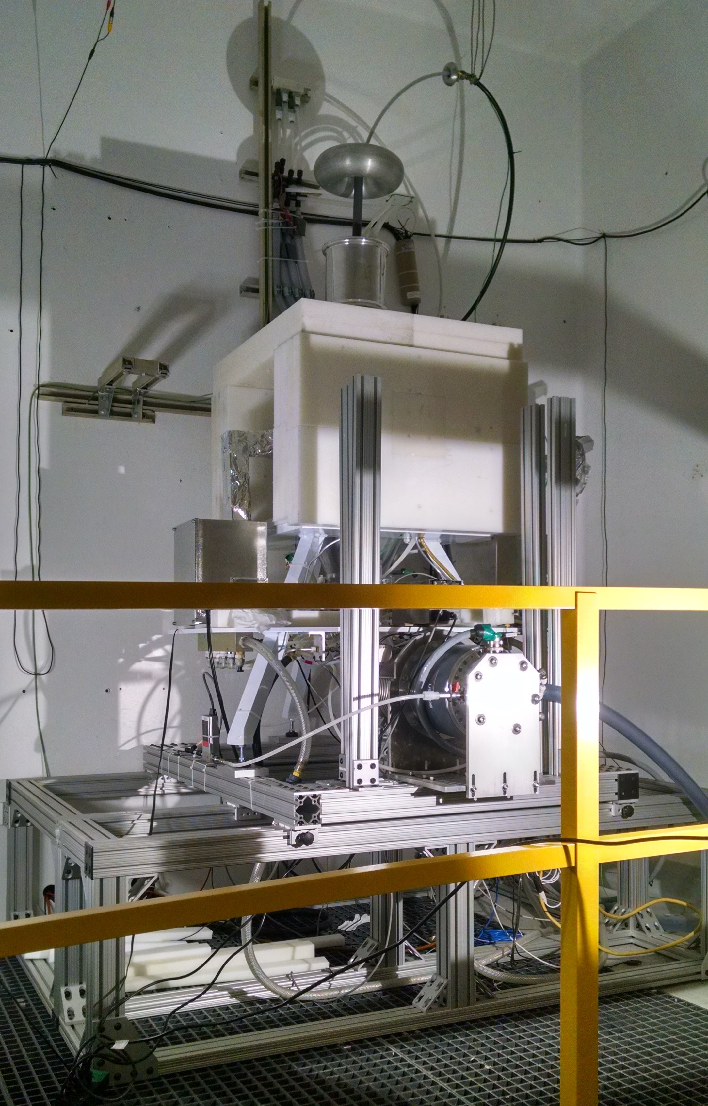
The UC Berkeley High Flux Neutron Generator
Zn
In

Slide 9
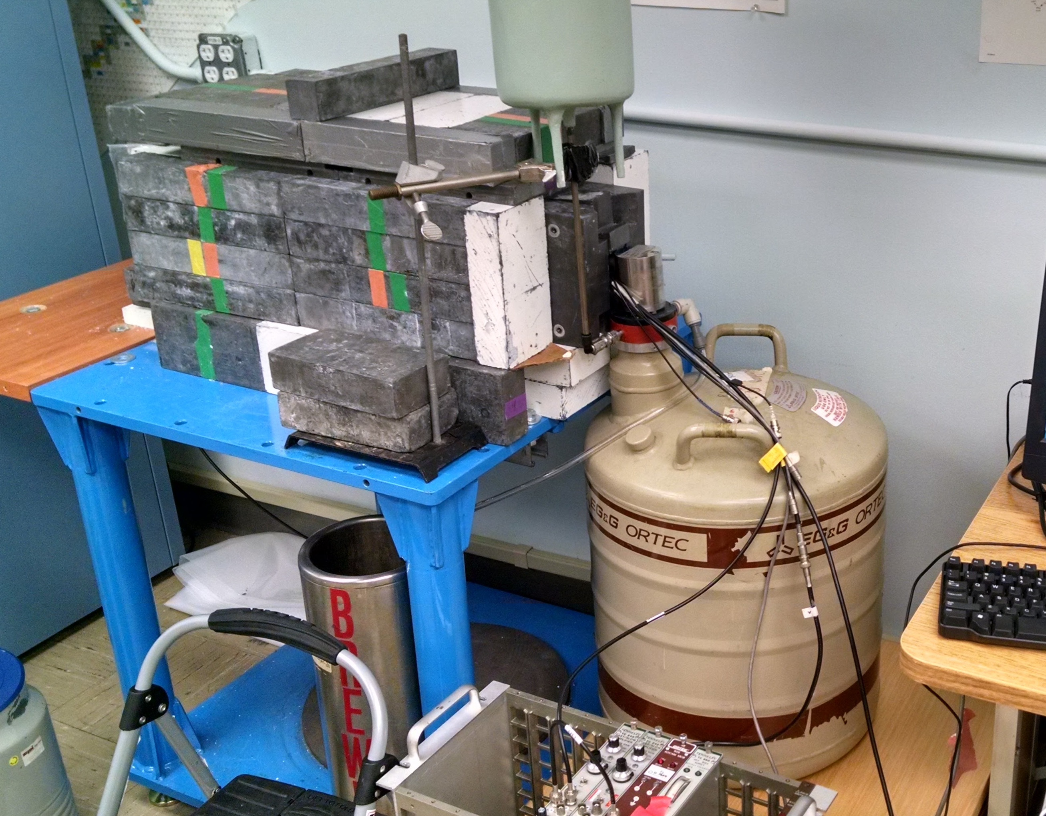
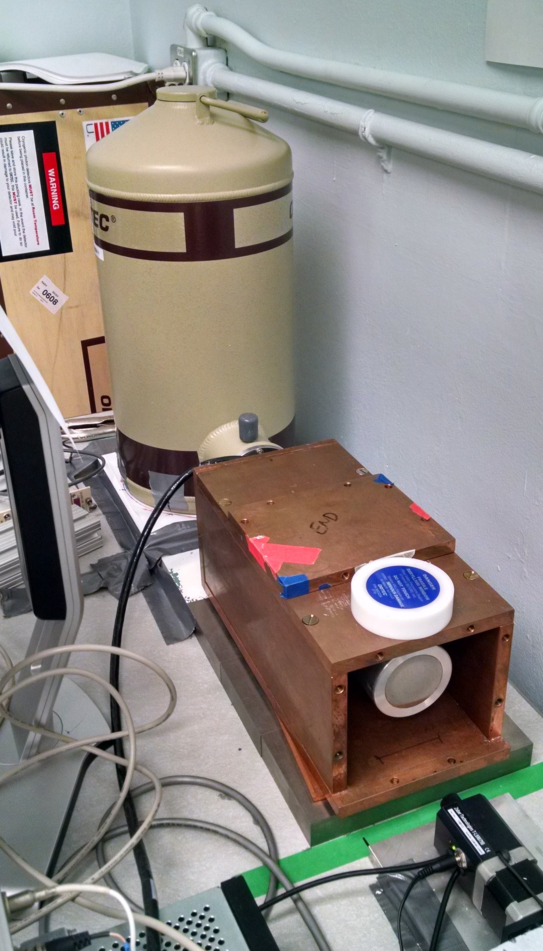
Relative Activation Measurements
Ortec Planar LEPS detector
Ortec 80% HPGe detector

Slide 10
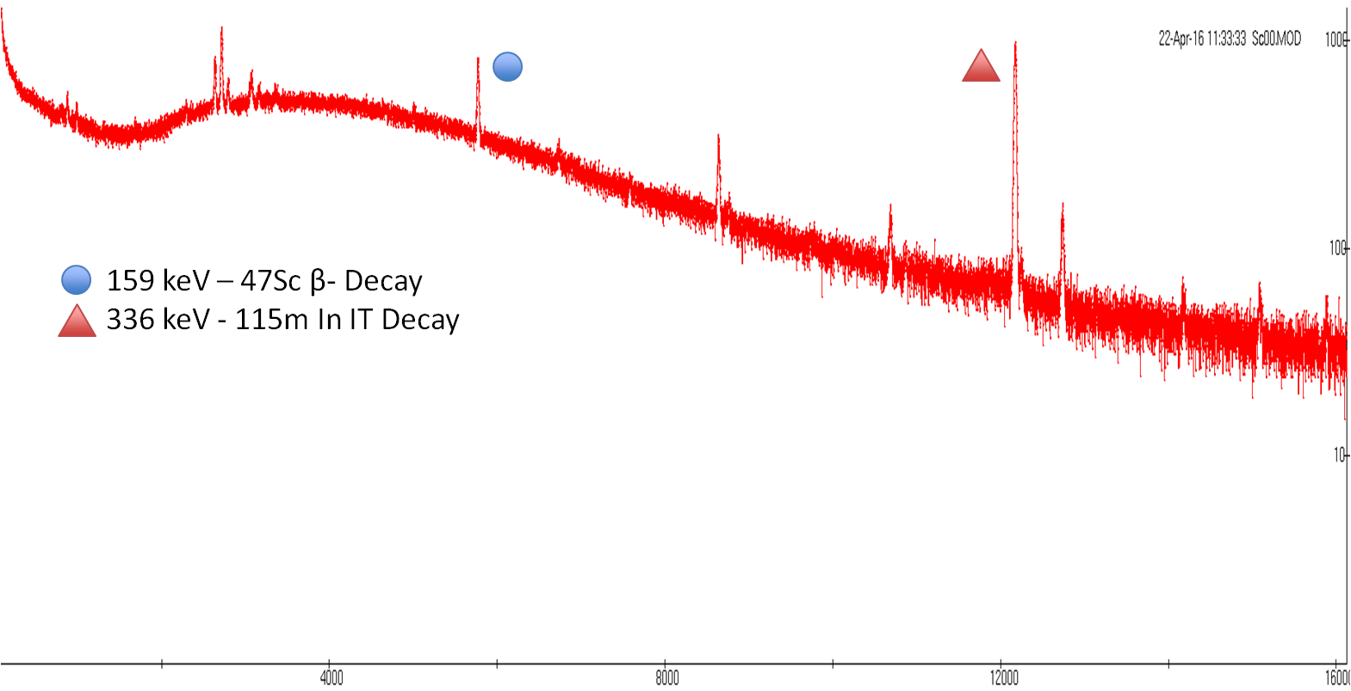
Relative Activation Measurements
336 keV - 115m In IT Decay
391 keV - 113m In IT Decay
417 keV - 116 In β- Decay
511 keV - 64 Cu β+ Decay

Slide 11
Relative Activation Measurements
t_{1/2} = 12.097 ± 0.8348 h
(ENSDF = 12.701 h)
χ² /ν = 1.743
t_{1/2} = 4.519 ± 0.044 h
(ENSDF = 4.486 h)
χ² /ν = 1.656
336 keV - 115m In IT Decay
391 keV - 113m In IT Decay
417 keV - 116 In β- Decay
511 keV - 64 Cu β+ Decay
Notes:
Producing O(10 kBq), with dead time < 5%

Slide 12
Relative Activation Measurements

Slide 13
Neutron Energy Spread
n
n
θ
n
Titanium
d
D
n

Slide 14
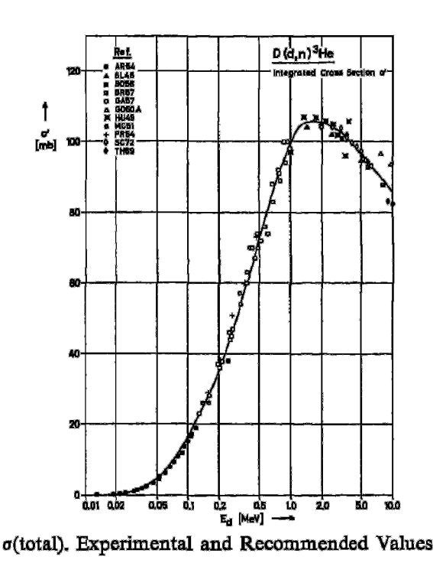
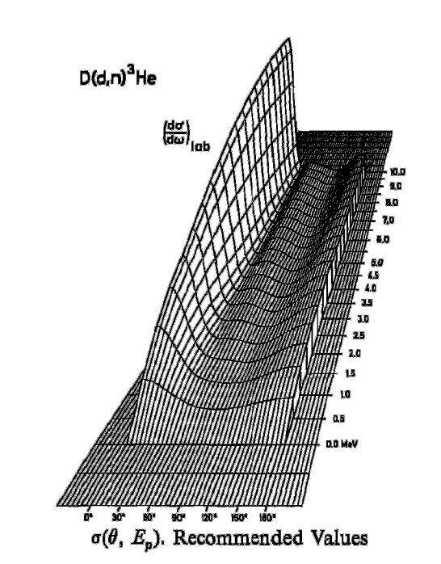
Neutron Energy Spread
H. Liskien et al., Nucl Data Tables, vol 11, 2973

Slide 15
Neutron Energy Spread

Slide 16
Neutron Energy Spread

Slide 17
Neutron Energy Spread

Slide 18
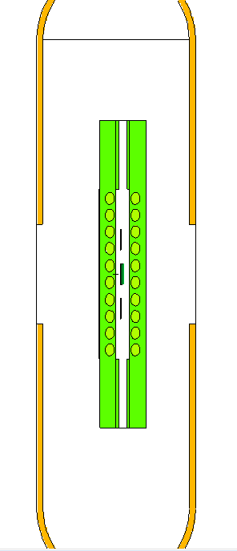
Neutron Energy Spread
Neutron flux profile modeled in each target and monitor foil, using MCNP6

Slide 19
Neutron Energy Spread
Before…

Slide 20
Neutron Energy Spread
After!

Slide 21
Neutron Energy Spread
After!

Slide 22
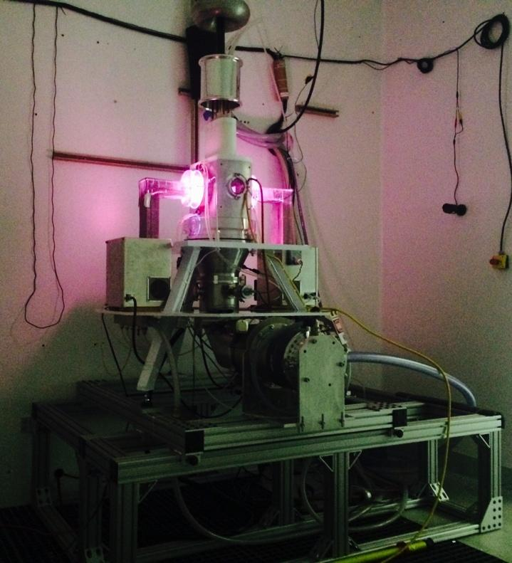
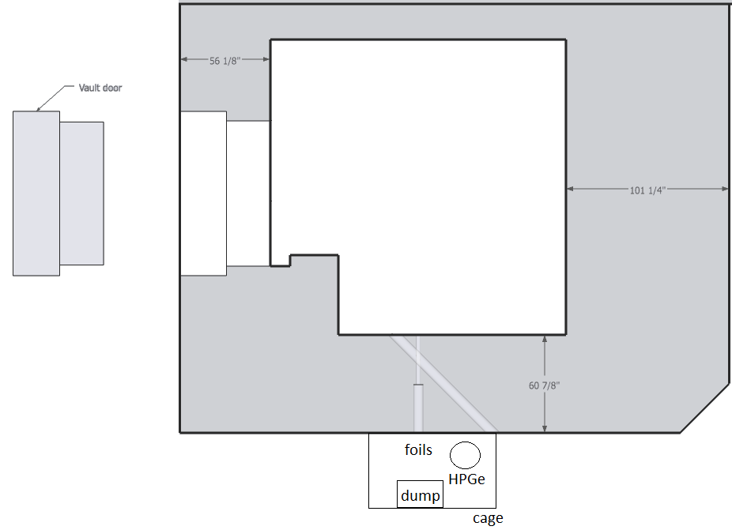
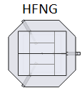
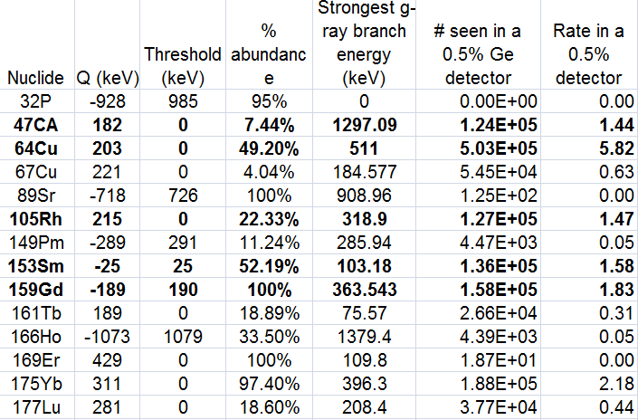
Future Work
Internal:
10⁸ n/s/cm²
Monoenergetic Beam: 10⁴⁻⁶ n/s/cm²

Slide 23
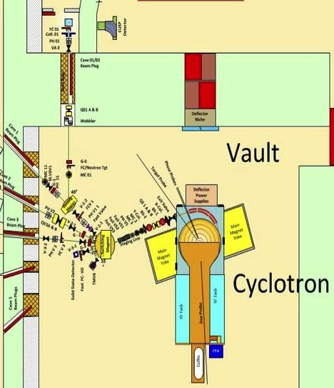
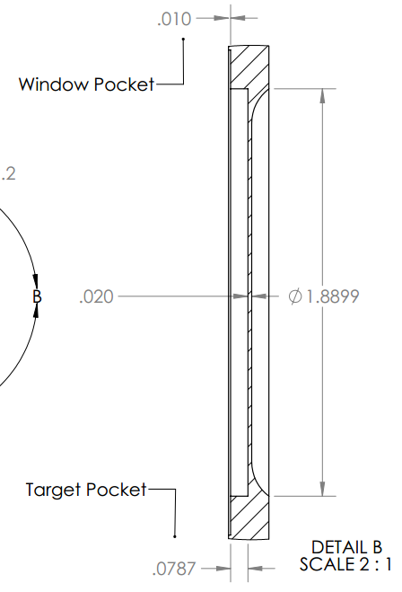
Future Work
(p/d/α, x) and (n,x) Cross Section Measurements at the LBL 88 Inch Cyclotron
⁷Li(p,n) neutron
production target

Slide 24
Acknowledgements
This work has been carried out at the University of California, Berkeley, and performed under theauspices of the U.S. Department of Energy by Lawrence Livermore National Laboratory under contract DE-AC52-07NA27344 and Lawrence Berkeley National Laboratory under contract # DE-AC02-05CH11231. Funding has been provided from the US Nuclear Regulatory Commission and the US Nuclear Data Program.
H. F. Aly et al., Microchim. Acta, vol. 59, no. 1, 1971.
K. S. Bhatki et al., J. Radioanal. Chem., vol. 2, no. 1–2, 1969.
T. H. Bokhari et al., J. Radioanal. Nucl. Chem., vol. 283, no. 2, 2010.
J. F. Briesmeister et al., Los Alamos National Laboratory, 1986.
M. B. Chadwick,et al., Nucl. Data Sheets, vol. 107, no. 12, 2006.
A. J. Koning et al., AIP Conference Proceedings, 2005, vol. 769, no. 2. H. Liskien et al., Nucl. Data Tables, vol 11, 1973.
M. R. Lewis et al., J. Nucl. Med., vol. 44, no. 8, Aug. 2003.
C. Müller et al., J. Nucl. Med., vol. 55, no. 10, Oct. 2014.
N. Otuka et al., Nucl. Data Sheets, vol. 120, 2014.
L. Pietrelli et al., J. Radioanal. Nucl. Chem., vol. 157, no. 2, 1992.
S. M. Qaim et al., IAEA Technical Reports Series No. 473, 2011.
D. Updegraff et al., “Nuclear Medicine without Nuclear Reactors or Uranium Enrichment,” 2013.

